Slide 1
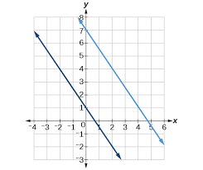
Bell Work
1.) Describe the graph in as many ways as you can think of...
2.) Describe the two equations in as many ways as you can think of…
y = 4x + 2
2y = 8x + 10
3.) How could you compare and contrast the graph and the two equations?

Slide 2
ALGEBRA 3
Day 4

Slide 3
Objective
Become familiar with the Graphing Calculators to manipulate equations to give us desired answers
Check out Textbooks
Become familiar with how to use the online textbook
Explore Teams

Slide 4

Graphing Calculator: Where are the buttons I need?!
6 + 3 = 9 – 15 = 24 / 4 =
8 * 3 = (6 + 2) – 4(3 – 5) =
$5^{2}$ = $2^{4}$ = ${−5}^{2}$ = $\sqrt{36}$ $\sqrt{40}$

Slide 5
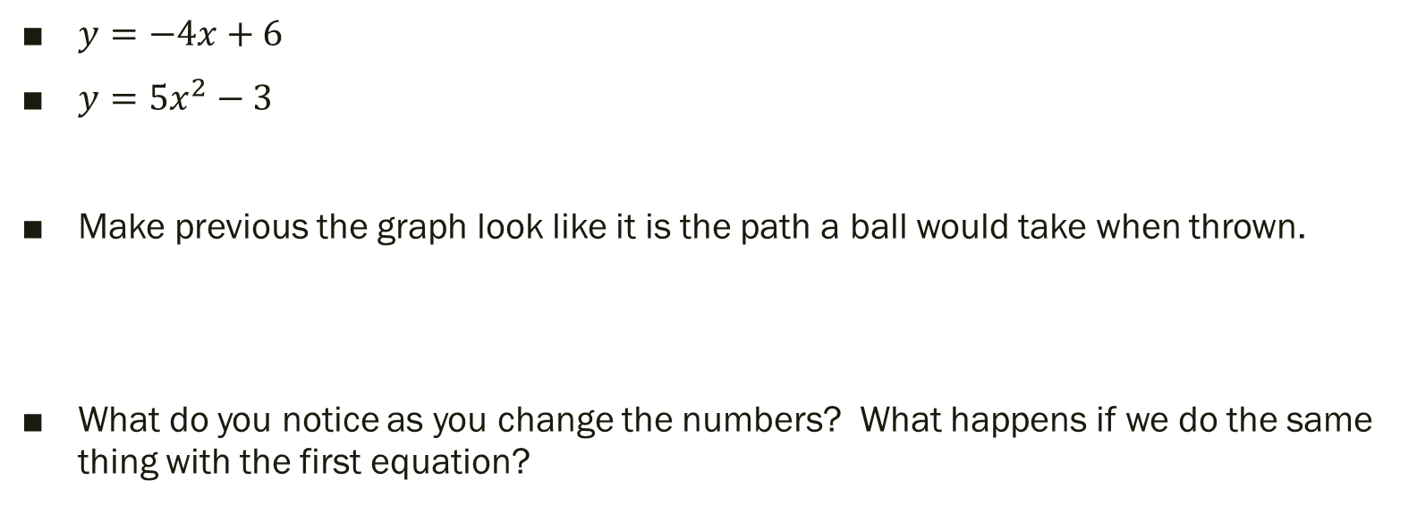
Graphing Calculator: Where are the buttons I need?!
$y=−4x+6$
$y=5x^{2}−3$
Make previous the graph look like it is the path a ball would take when thrown.
What do you notice as you change the numbers? What happens if we do the same thing with the first equation?

Slide 6
Text Book Check Out
When I call your name if you want a textbook:
1.) Grab the next one in order off the shelf,
2.) Tell me the number
3.) Grab a condition form, and fill it out
4.) Take the book home
While waiting for your turn to get a book use your calculator to work on the following:
1.) List the fewest and most amount of operations you find to get an answer of 24
2.) Find 3 different pairs of answers for the following, and prove why you know they work: 6x + 8y = 48
3.) Using all of the operations of PEMDAS, create a statement that yields the year you were born as the answer. (Challenge: Use your month and day also)

Slide 7
Using the Online Text Book
Log into your Office 365 account
Click on the Waffle
Click “All”
Search “Pearson”
Select our class and open the book

Slide 8
Using Teams
Online Discussion
Notes and PowerPoints

Slide 9
More with Graphing Calculators
Pros and Cons of the New Calculator
Discussion: What do you like/hate about them so far?
What do we need to practice more of with them?

Slide 10
Exit Ticket: Back to the Bell Work… ●How could the graphing Calculator help you with this problem?
2.) Describe the two equations in as many ways as you can think of…
1.) Describe the graph in as many ways as you can think of...
y = 4x + 2
2y = 8x + 10
3.) How could you compare and contrast the graph and the two equations?

